Slide 1
Aaron Riggs, Andre Manz, Chris Baierski, Wesley Scott as
DrinkTank Present
Phil The automated bartender (Implementation Plan & Partial Demo)

Slide 2
What is PHIL again³?
P.H.I.L.
Please Have Infinite Liquor
Goals
Reduce operating cost and loss for a bar to operate under rush conditions.
Reduce the amount of drinks that are over poured and spilled.
Reduce the amount of menial drinks that are made by the bartender.

Slide 3
Implementation Overview
Fixed the pumps turning on when the system started
Fixed issues with power draw by powering the RPi with a phone charger
Going to make a more permanent tube holder for pouring
Going to calibrate the touch screen
Going to push updates to the GUI and business logic that will be touched on later

Slide 4
How much work has been done?
As you’ve already seen, we have been pouring drinks for some time.
We have completed our MVP goals, and are just working on tidying everything up and making improvements.
Hardware and GUI are fully functional; backend and voice AI are coming along well.

Slide 5
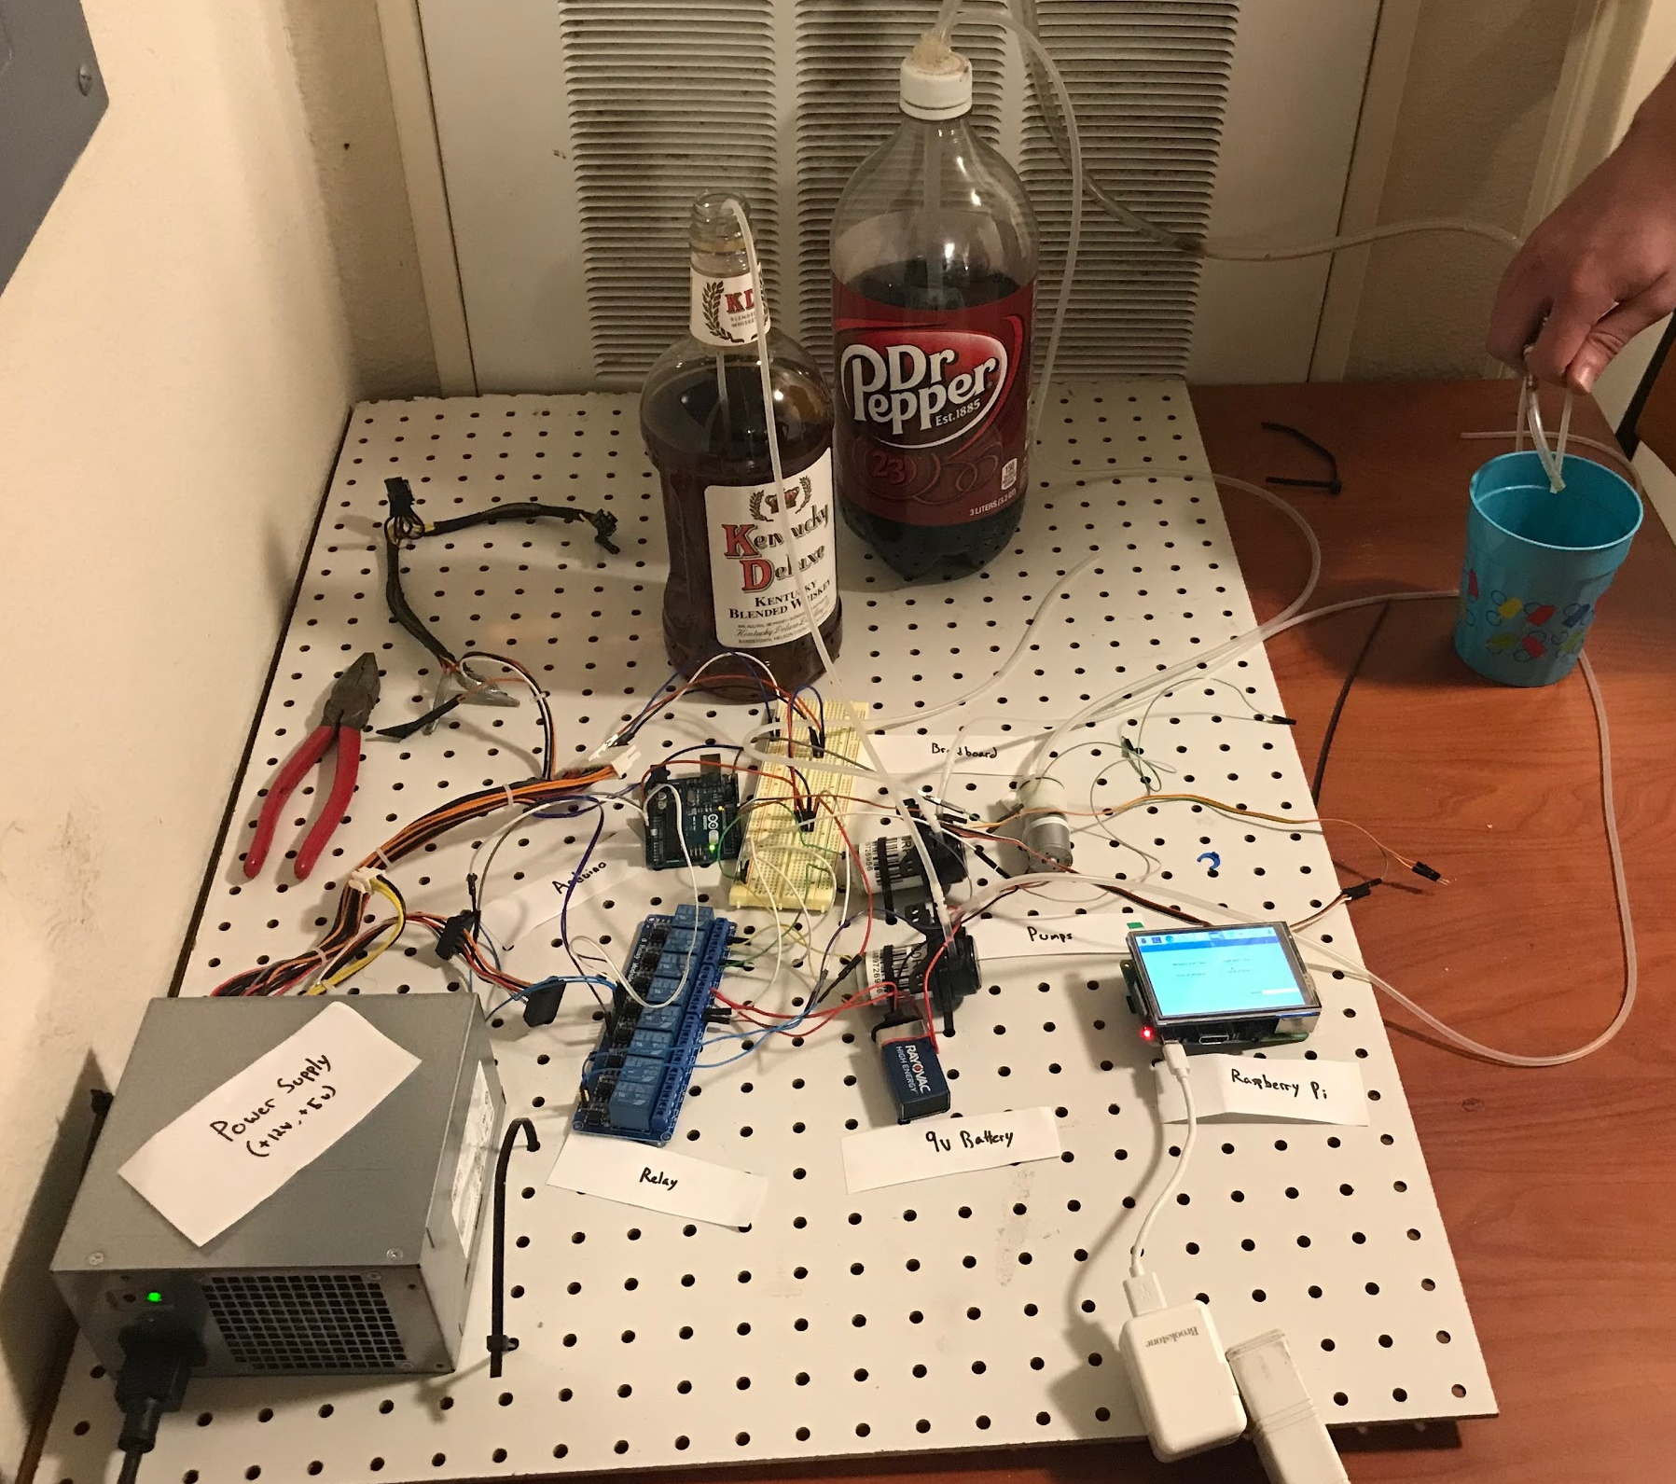
What have we completed?
Full hardware setup (RPi, Arduino, Relay, power supply, pumps & hoses)
Version 1.0 of the GUI has been completed
Database relations and stat logs have been designed and coded
Basic Voice recognition testing

Slide 6
What we’re still working on
Version 2 of the GUI
Making it look better, and allow for more dynamic drink creation/removal
Hardware tweaks
Get rid of leaks, and put it in a portable container
More voice functionality
Get more voice commands working

Slide 7
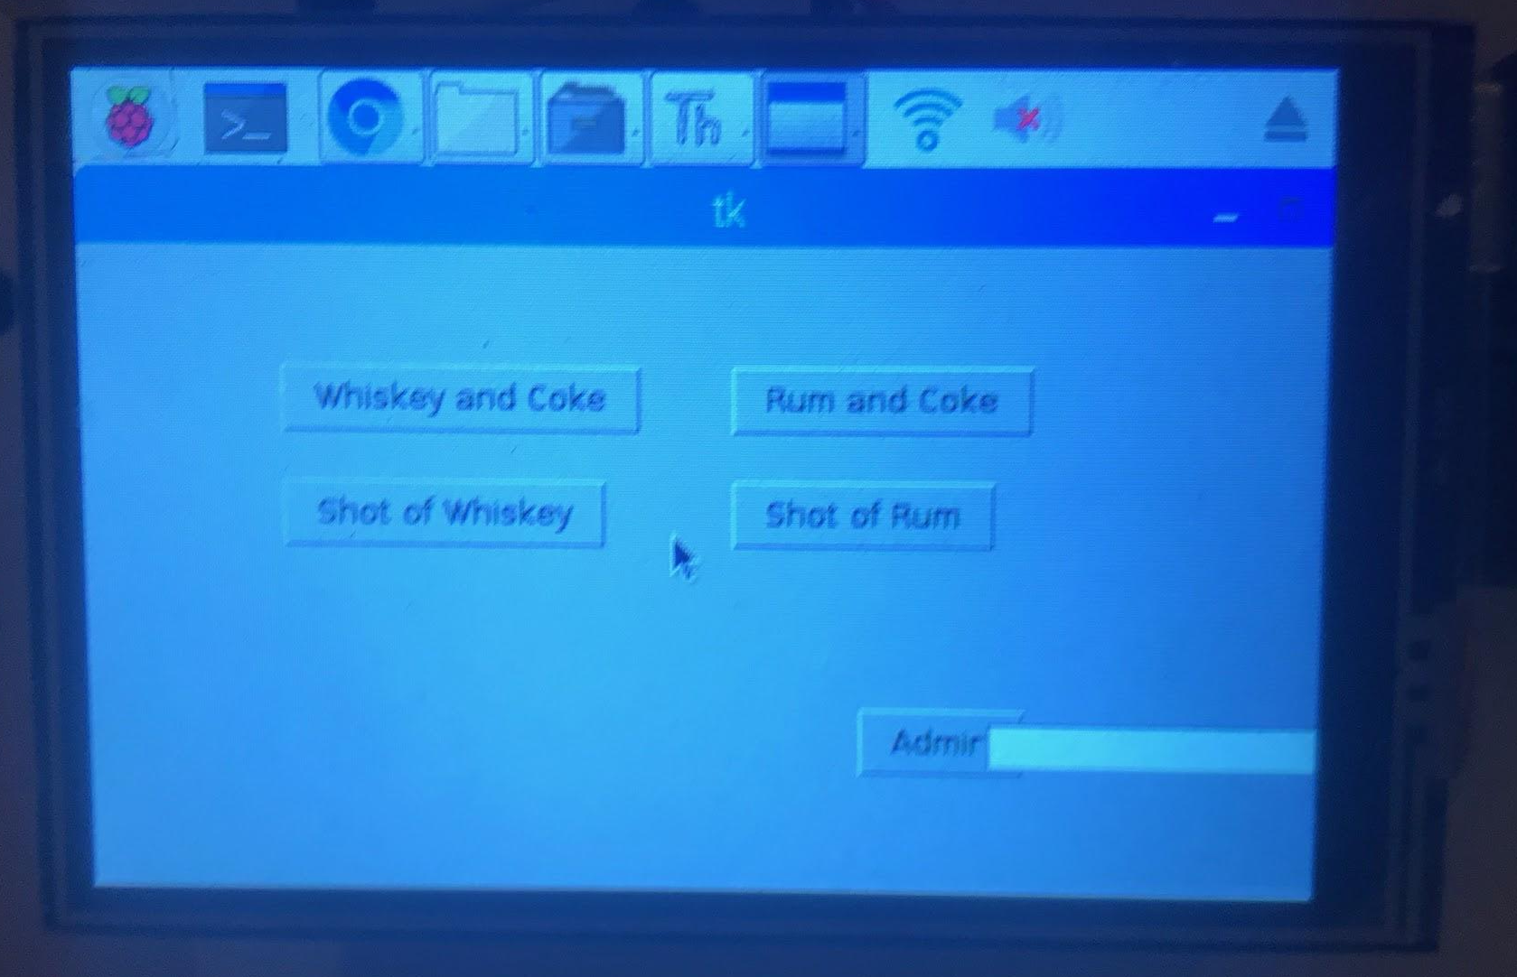
Issues we’re still facing
Some minor pump leaks with the Soda
GUI isn’t all that visually appealing
Voice Recognition implementation

Slide 8
Overall comments/feelings about PHIL
Was a great project
We had a lot of fun, and learned a lot
Development was relatively fast and smooth
We got to drink for academic purposes
(DrinkTank LLC takes no responsibility for actions taken under the influence of alcohol provided by PHIL)

Slide 9

Partial Demo
(DrinkTank LLC takes no responsibility for actions taken under the influence of alcohol provided by PHIL)

